Slide 1
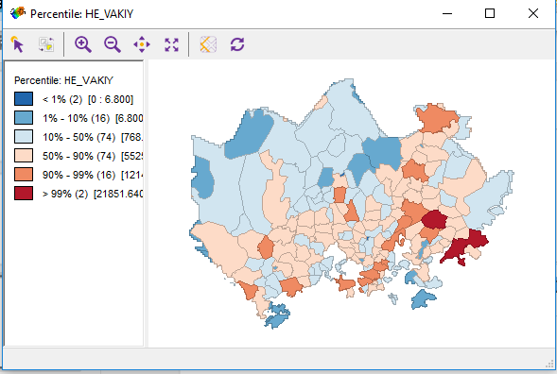
Notes:
he_vakiy Inhabitants, total, 2015 (HE)

Slide 2
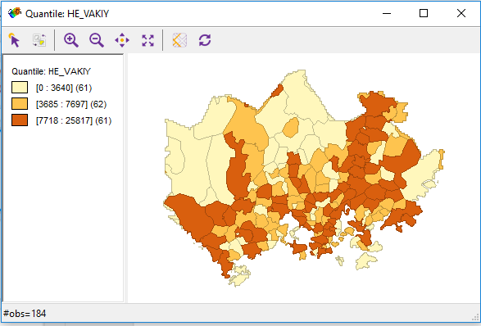

Slide 3
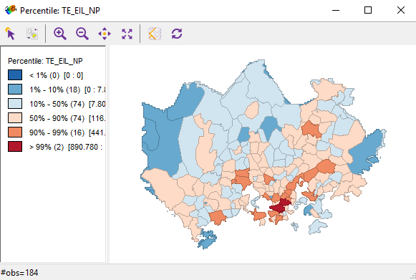
Notes:
Using percentiles.
te_eil_np Young couples without children, 2015 (TE)

Slide 4
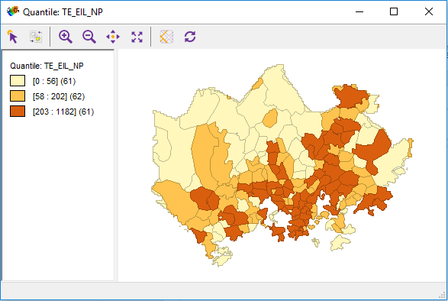
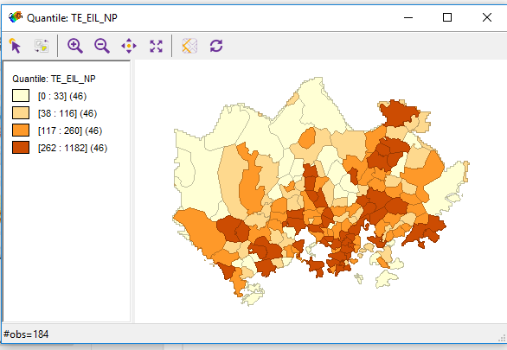

Slide 5
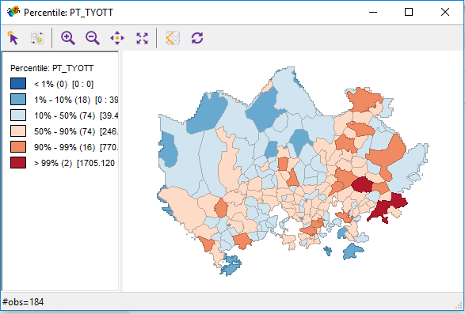
Notes:
pt_tyott Unemployed, 2014 (PT)

Slide 6
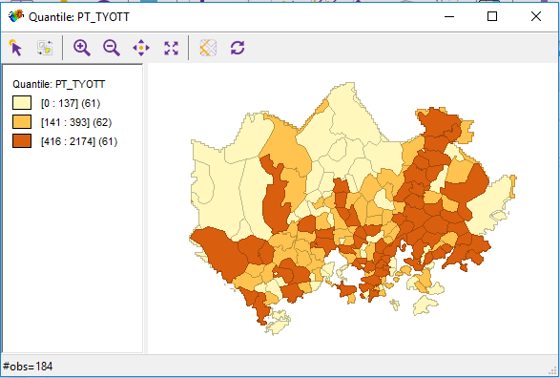

Slide 7
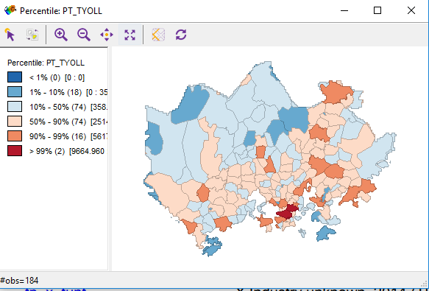
Notes:
pt_tyoll Employed, 2014 (PT)

Slide 8
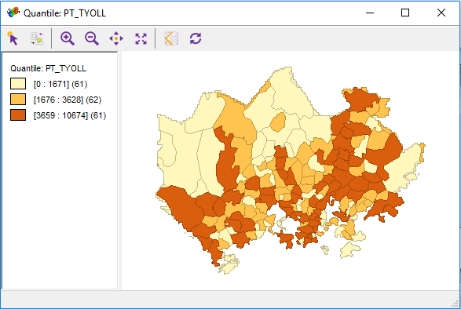

Slide 9
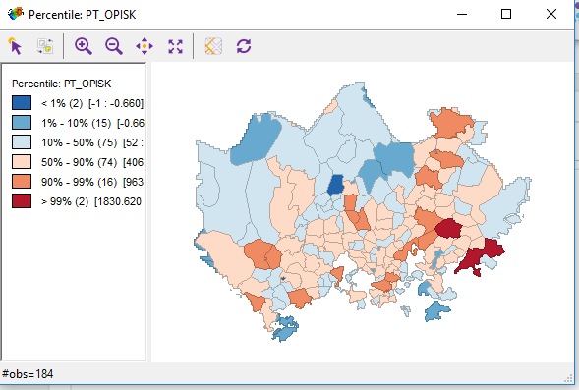
Notes:
pt_opisk Students, 2014 (PT)

Slide 10
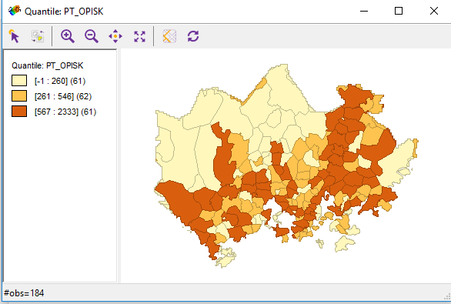

Slide 11
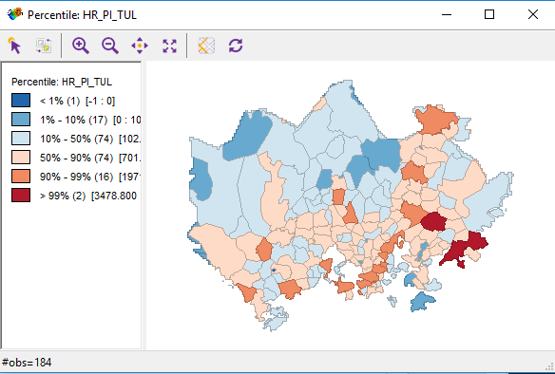
Notes:
hr_pi_tul Inhabintants belonging to the lowest income category, 2014 (HR)

Slide 12
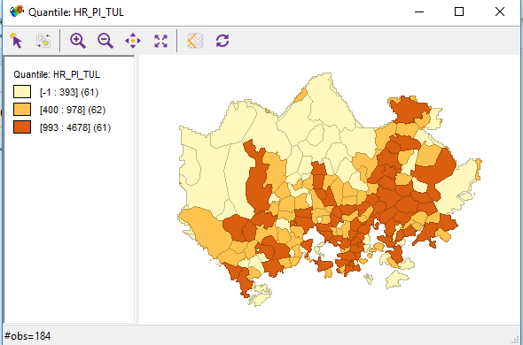

Slide 13
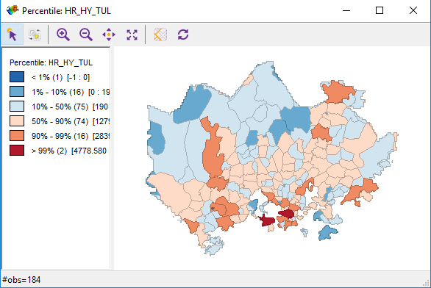
Notes:
hr_hy_tul Inhabintants belonging to the highest income category, 2014 (HR)

Slide 14
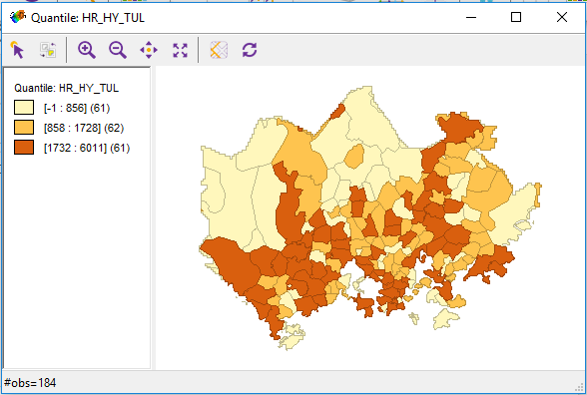

Slide 15
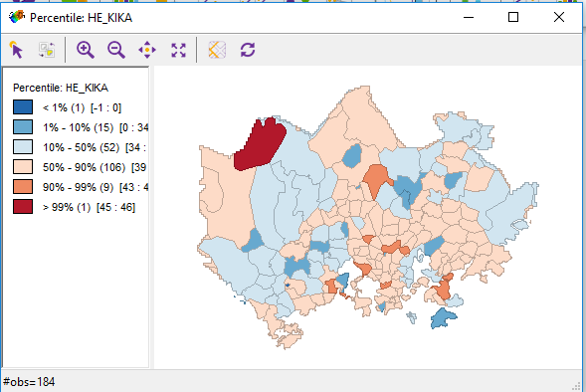
Notes:
he_kika Average age of inhabitants, 2015 (HE)

Slide 16
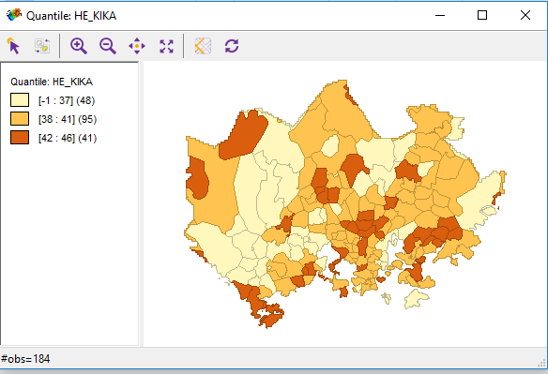

Slide 17
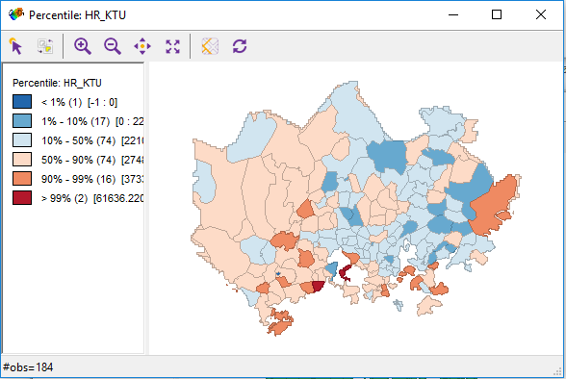

Slide 18
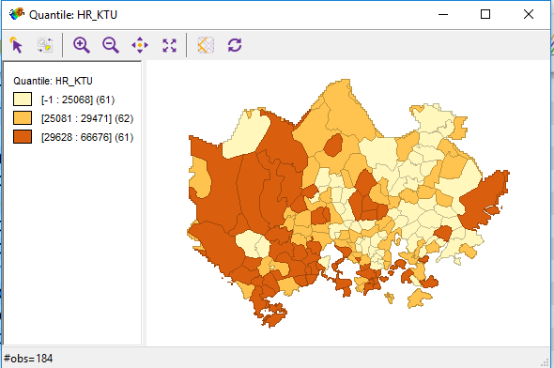

Slide 19
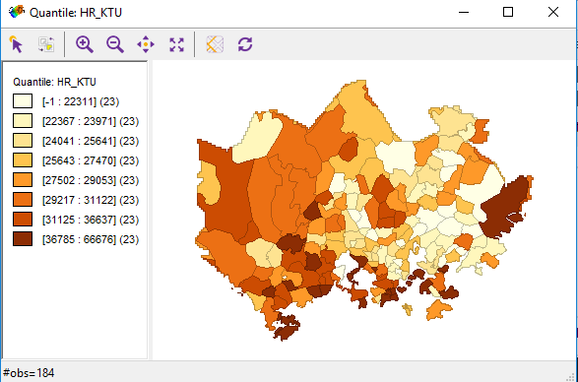
Notes:
Now, focus on income

Slide 20
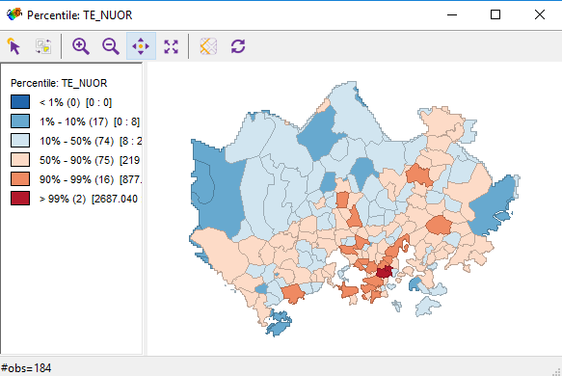

Slide 21
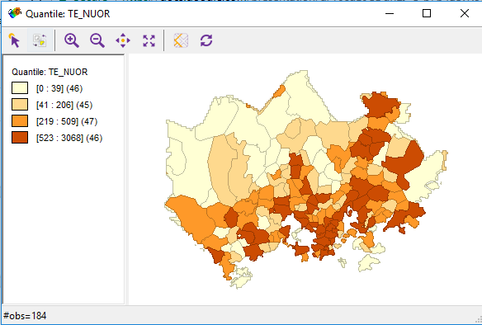

Slide 22
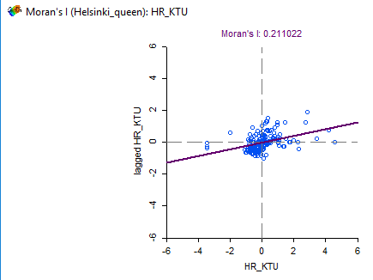

Slide 23
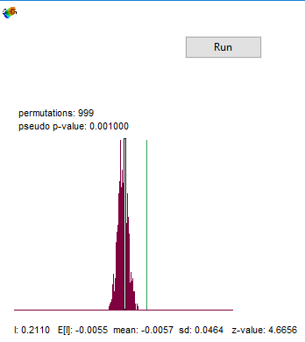

Slide 24
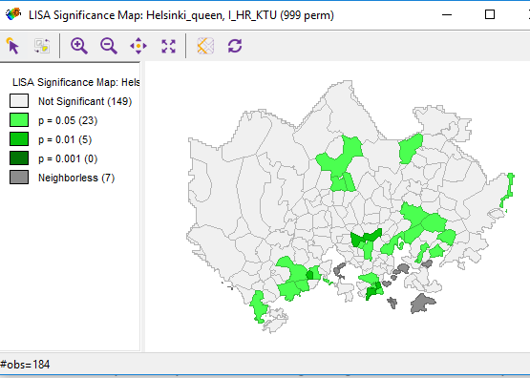
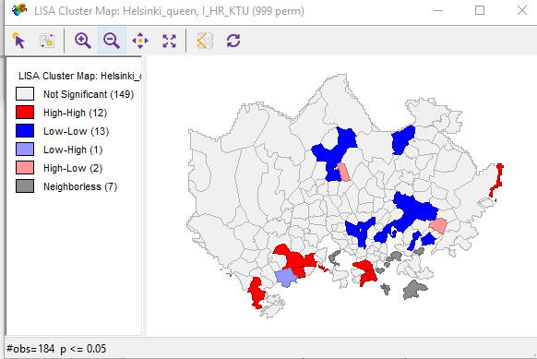

Slide 25
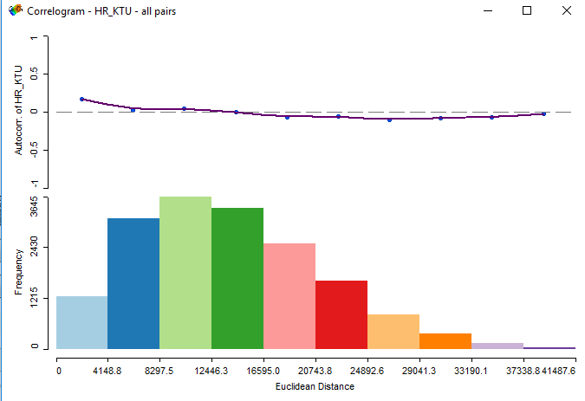

Slide 26
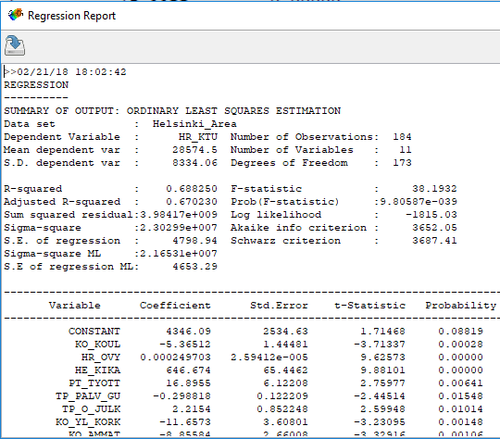

Slide 27
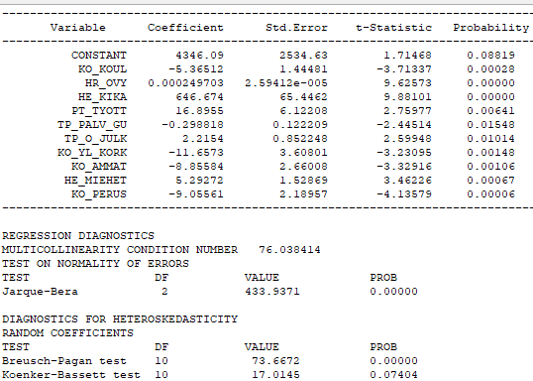

Slide 28
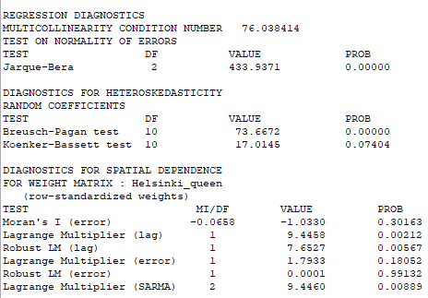

Slide 29
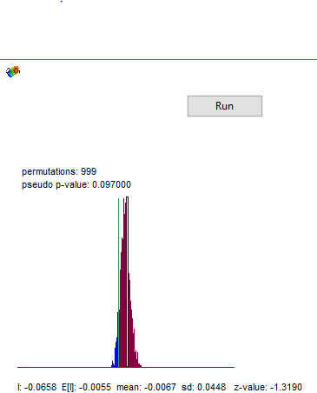
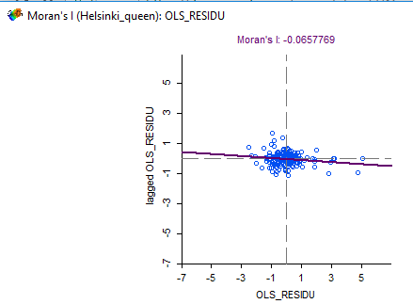

Slide 30
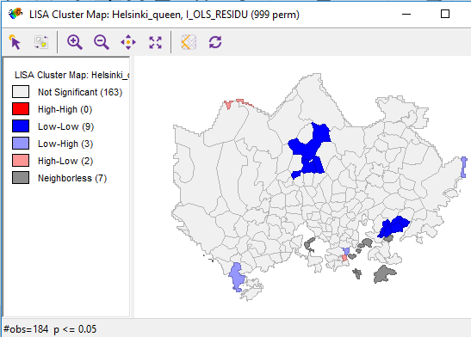
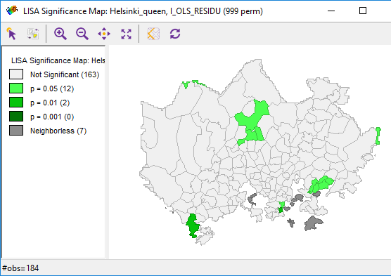

Slide 31
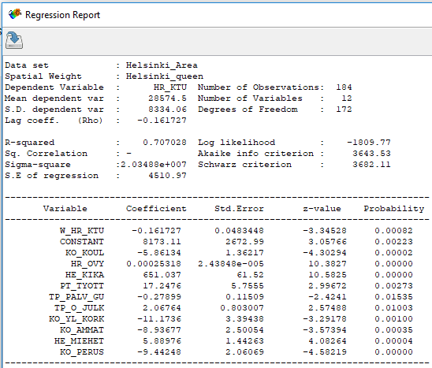
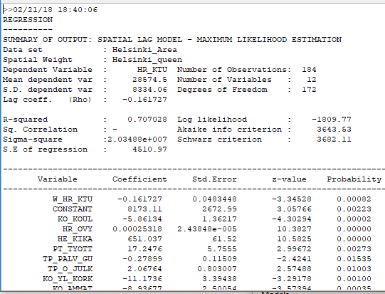

Slide 32
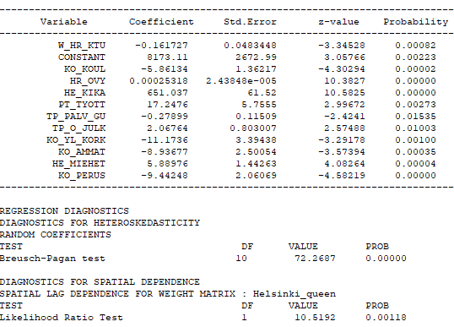

Slide 33
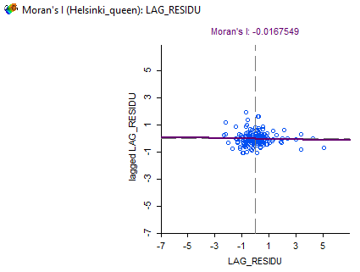
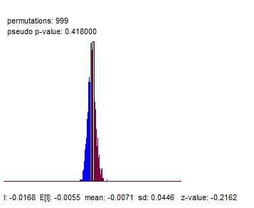

Slide 34
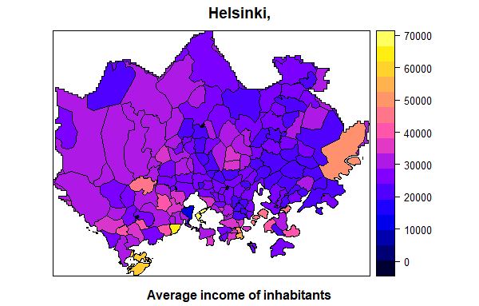

Slide 35
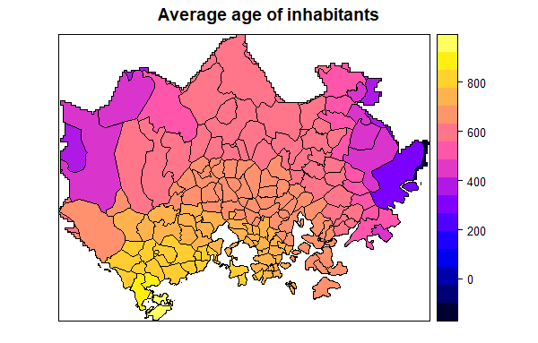

Slide 36
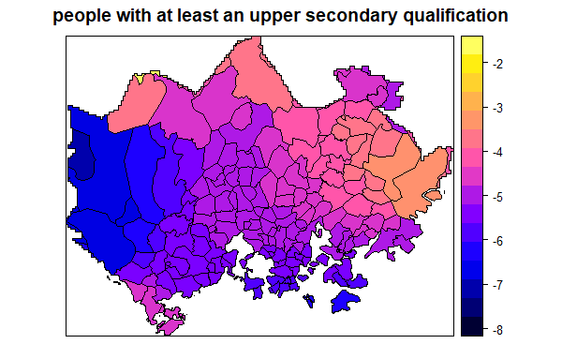

Slide 37
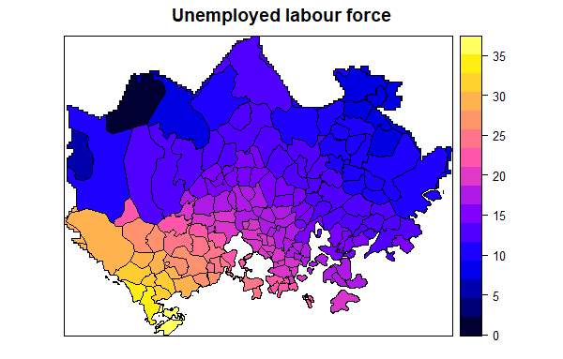

Slide 38
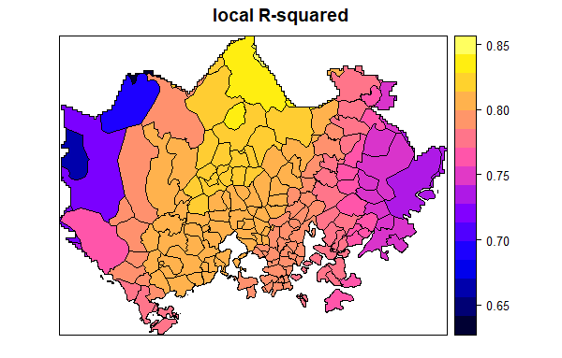

Slide 39
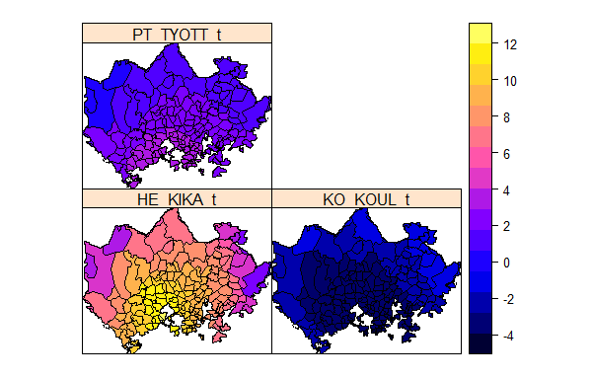

Slide 40
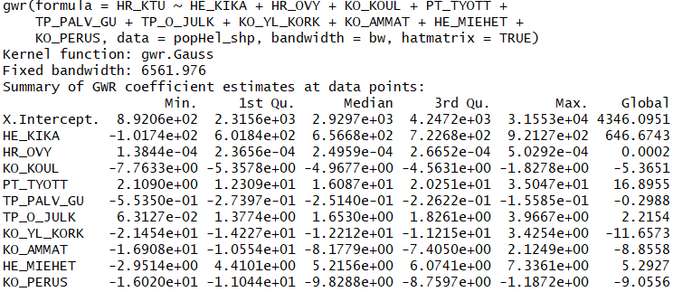

Slide 41
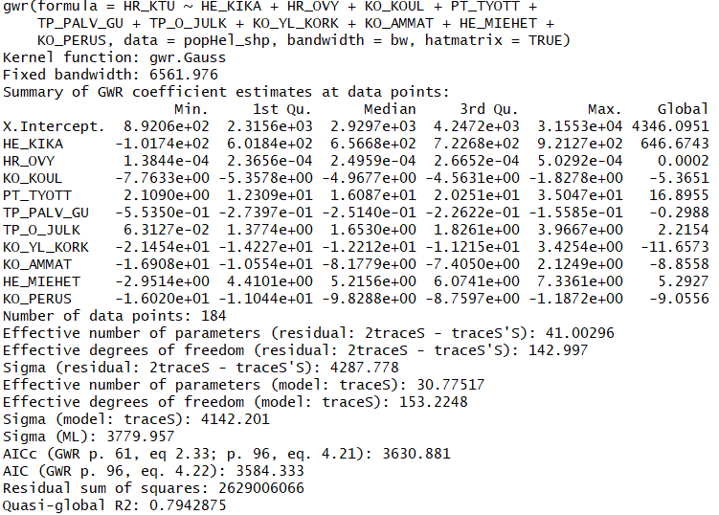

Slide 43
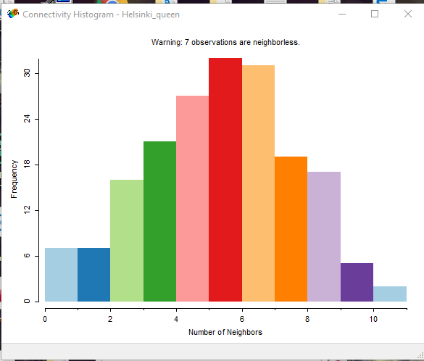
Notes:
Queen contiguity

Slide 44
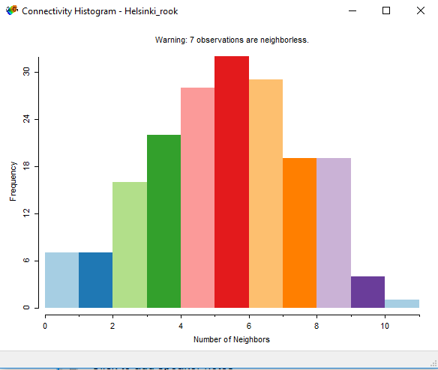

Slide 45
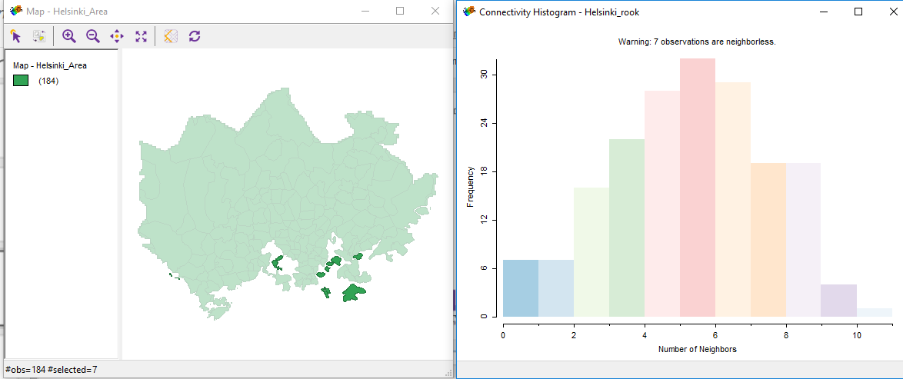

Slide 46



Slide 47

Notes:
7 locations with no neighbours

Slide 48


Slide 49


Slide 50


Slide 51


Slide 52


Slide 53

Notes:
students

Slide 54


Slide 55


Slide 56


Slide 57


Slide 58


Slide 59


Slide 60


Slide 61


Slide 62


Slide 63


Slide 64


Slide 65
Unemployment:
Dependent variable: pt_tyott
Independent explanatory variables: he_vakiy, he_miehet , he_naiset , he_kika, ko_perus, ko_koul , ko_yliop , ko_ammat , ko_al_kork, ko_yl_kork , hr_tuy , hr_ktu , hr_mtu , hr_ovy , te_eil_np ,te_aik, te_elak, te_omis_as , te_vuok_as , te_muu_as , tr_ovy, tr_ktu , tr_mtu,tr_pi_tul , tr_ke_tul , tr_hy_tul , pt_opisk , pt_elakel
Final: PT_TYOTT ~ KO_KOUL + KO_YLIOP + KO_AL_KORK + HR_KTU + HR_OVY + TE_ELAK +
TE_VUOK_AS + TR_OVY + TR_KTU + TR_PI_TUL + PT_ELAKEL

Slide 66


Notes:
Error is insignificant, so, i can stop at OLS

Slide 67



Slide 68


Slide 69


Slide 70

Notes:
Slm and sem are insignificant, so is the spatial autocorrelation in the error, thus, im sticking to the OLS.

Slide 71


